Slide 1


Tariffs Affecting Global Trade
Overview of recent tariffs impacting international commerce
by A k Satpute

Slide 2
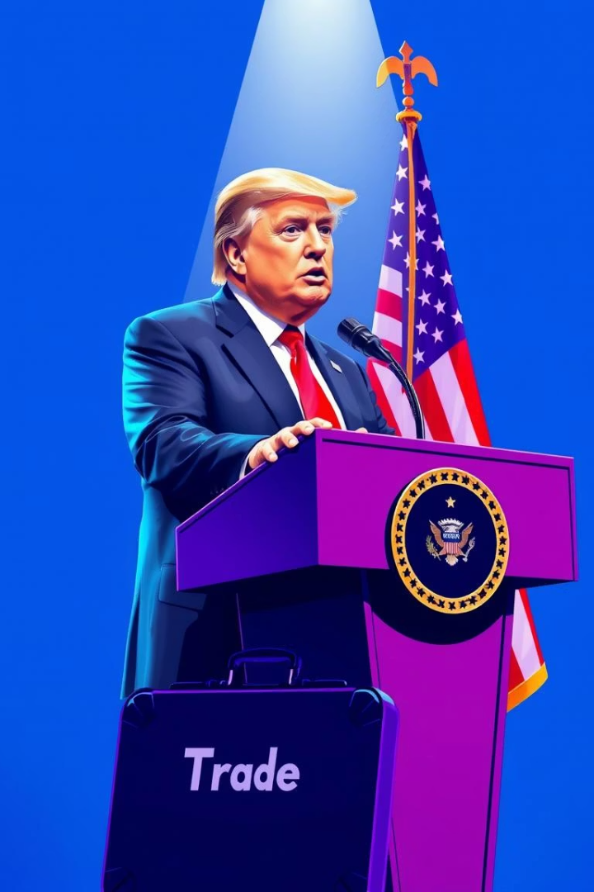
U.S. Tariff Actions
10% Blanket Tariff
Additional Tariffs
Applied broadly on imports to U.S.
Targeted 75 countries before suspension
Pause Since April 9
Temporary halt on additional tariffs

Slide 3
International Negotiations
Ongoing Talks
Trade Frameworks
Multiple nations engaging with U.S.
Developing new trade agreements
Seeking tariff reductions
Preliminary deals emerging
Discussing trade balances
Aim for mutual benefit

Slide 4
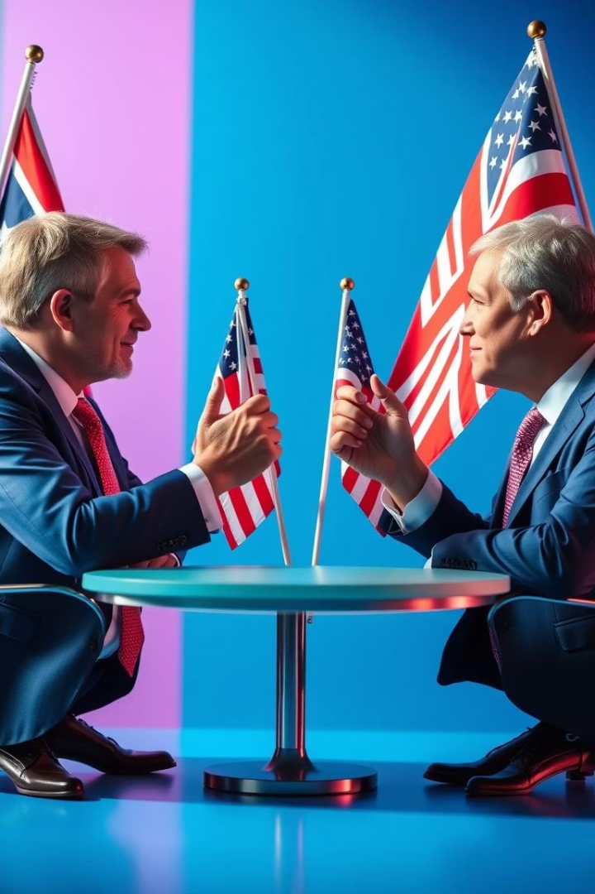
U.K. Trade Agreement
Preliminary Trade Deal
Key Benefits
Reduced tariffs on goods
U.K. reached agreement with U.S.
Strengthened bilateral relations
Future Steps
Further negotiations expected

Slide 5

Concerns from Canada
Trade Disruptions
Diplomatic Pressure
Impact on export industries
Seeking tariff relief
Negotiation Challenges
Complex bilateral issues

Slide 6



Concerns from China
2
Trade Imbalance
Calls for fairer terms
Economic Impact
1
Exports affected by tariffs
Political Tension
3
Geopolitical trade consequences

Slide 7




Industry Disruptions
Manufacturing Delays
Slowed production and shipping
Rising Costs
Higher tariffs increase expenses
Market Uncertainty
Companies hesitant on investment

Slide 8

Key Takeaways & Next Steps
Monitor Negotiations
Track progress with key trade partners
Assess Industry Impact
Identify sectors hit hardest
Prepare Policy Response
Design support measures for affected business
Encourage Dialogue
Promote multilateral trade discussions

